Slide 1
Enterprise Systems

Slide 2
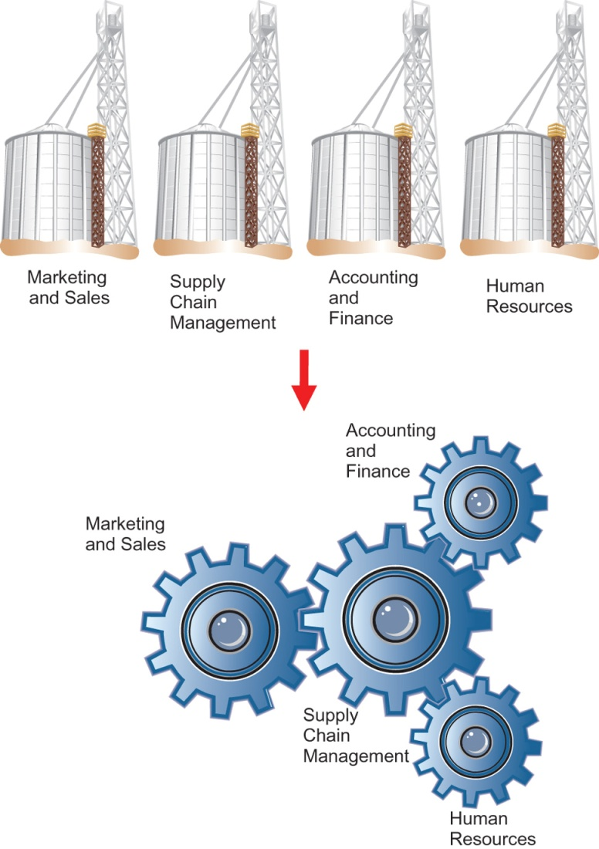
Information Systems in Enterprises

Slide 3
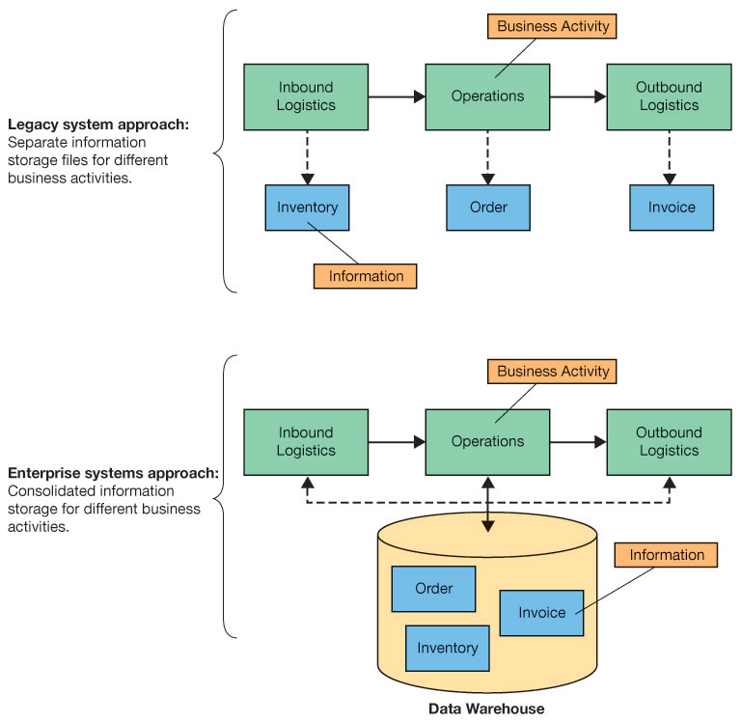
Legacy System Approach

Slide 4
Information Silos
An information silo exists when data is isolated in separated information systems
How Do Information Silos Arise?
Data isolated in islands of automation
Different department goals
Different personal and workgroup needs
Duplicate data as organization grows
Notes:
An information silo exists when data is isolated in separated information systems.
Information system silos arise when:
IS supports departmental processes rather than enterprise-level processes.
Personal and workgroup support applications are created over time.
Organizations grow, especially by merger and acquisitions.

Slide 5
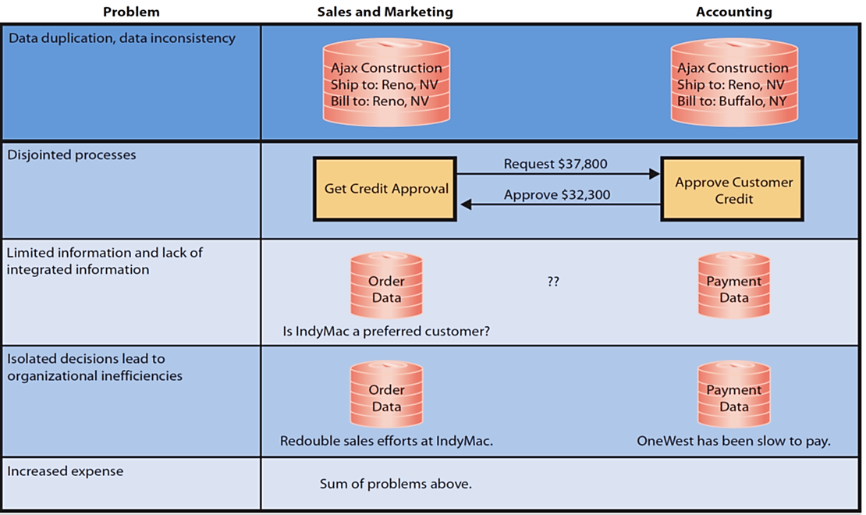
Problems Created by Information Silos
Notes:
This table summarizes problems of information silos.
Duplicated and inconsistent data.
Separated supporting applications; difficult for two activities to reconcile their data, getting approvals will be slow and possibly erroneous.
Lack of integrated enterprise data as a consequence of disjointed systems.
Inefficiency results from making decisions in isolation.
Information silos increase costs — duplicated data, disjointed systems, limited information, and inefficiencies all mean higher costs.

Slide 6
Enterprise System Approach

Slide 7
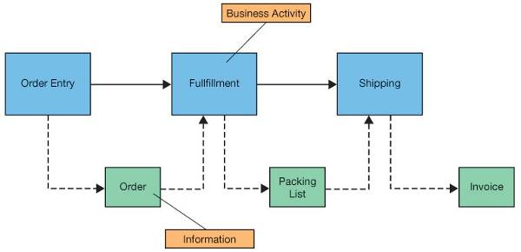
Supporting Business Processes
Internally focused systems
Support functional areas, business processes, and decision making within an organization
New information (value) is added at every step

Slide 8
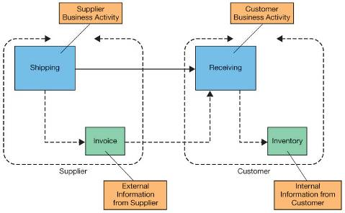
Supporting Business Processes
Externally focused systems (interorganizational systems)
Coordinate business activities with customers, suppliers, business partners, and others who operate outside the organization
Streamline the flow of information between companies

Slide 9
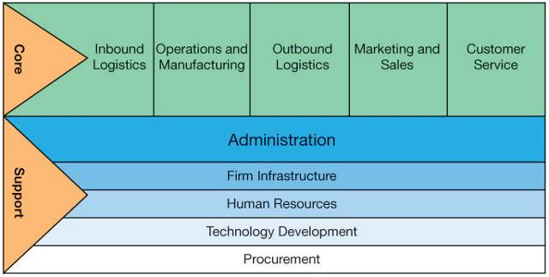
Internally Focused Applications: Value Chain
Flow of information through a set of business activities
Core activities: functional areas that process inputs and produce outputs
Support activities: enable core activities to take place
Source: textbook[2], page 283

Slide 10
Value chain - Core Activities
Inbound logistics activities
Receiving and stocking raw materials, parts, and products
Operations and manufacturing activities
Order processing and/or manufacturing of end products
Outbound logistics activities
Distribution of end products
Marketing and Sales activities
Presale marketing activities
Customer service activities
Post-sale activities

Slide 11
Value chain - Support Activities
Administrative activities
Support of day-to-day operations (for all functional areas)
Infrastructure activities
Implement hardware and software needed
Human resource activities
Employee management
Technology development activities
Design and development of applications to support the primary activities
Procurement activities
Purchasing of goods and services (inputs into the primary activities)

Slide 12
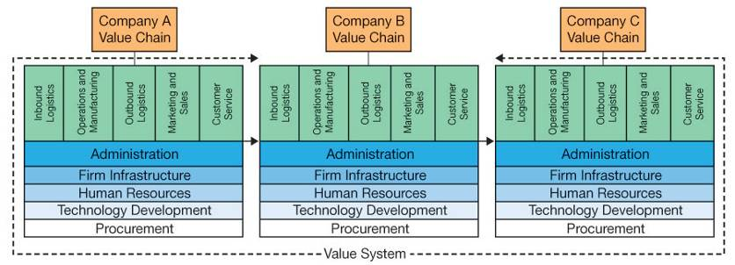
Externally Focused Applications—Value System
Coordination of multiple value chains

Slide 13
Externally Focused Applications—Value System
Information Flows in a Value System
Upstream information flow: information received from another company
Downstream information flow: information produced by a company and sent to another organization

Slide 14
Q4 What is CRM?

Slide 15
Customer Relationship Management (CRM)
Suite of applications, a database, and a set of inherent processes.
Manage all interactions with customer through four phases of customer life cycle:
Marketing, customer acquisition, relationship management, loss/churn.
Intended to support customer-centric organization.
Notes:
CRM is a suite of applications, a database, and a set of inherent processes for managing all interactions with a customer from lead generation to customer service. Every contact and transaction with customer is recorded in CRM database.
inherent processes: predesigned procedures for using the software products

Slide 16
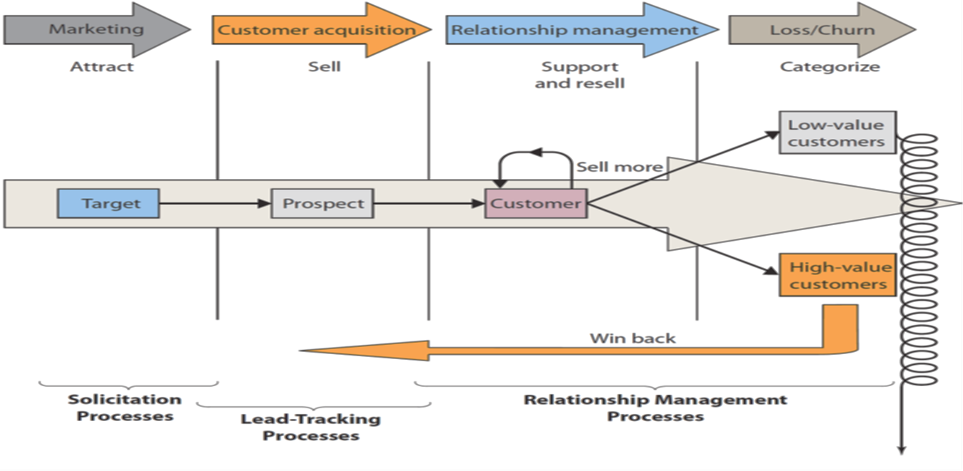
Customer Life Cycle
Notes:
Marketing sends messages to target market to attract customer prospects. When prospects order, they become customers who need to be supported. Additionally, relationship management processes increase the value of existing customers by selling them more products.
Over time, organization loses some customers. When this occurs, win-back processes categorize customers according to their value and attempt to win back and turn them into high-value customers.

Slide 17
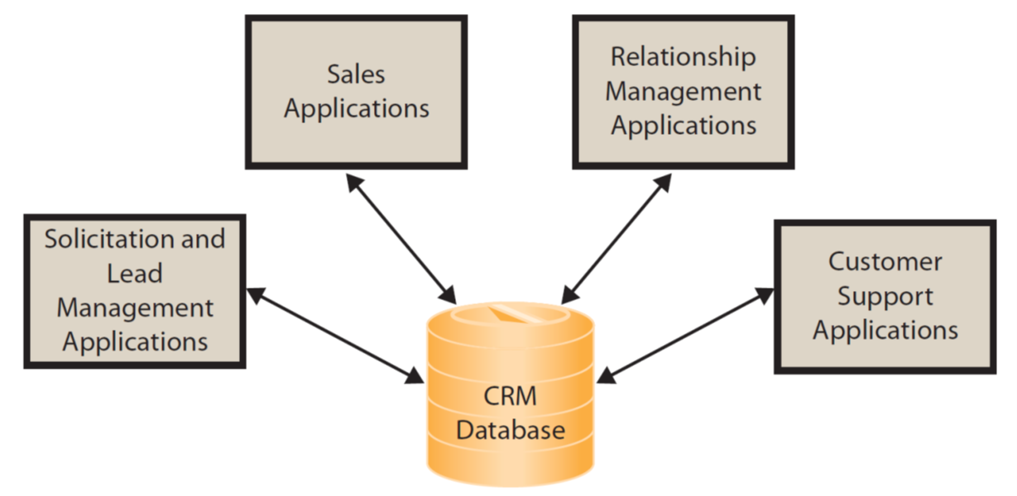
CRM Applications
components exist for each stage of the customer life cycle
Notes:
CRM components exist for each stage of the customer life cycle. As shown, all applications process a common customer database. This design eliminates duplicated customer data and removes the possibility of inconsistent data. It also means that each department knows what has been happening with the customer at other departments.

Slide 18
Q3 What is ERP?

Slide 19
Enterprise resource planning (ERP)
ERP: a suite of applications called modules, a database, and a set of inherent processes for consolidating business operations into a single, consistent, computing platform.
An ERP system is an information system based on ERP technology
primary purpose: integration
Notes:
inherent processes: predesigned procedures for using the software products

Slide 20
Enterprise resource planning (ERP)
An ERP system integrate:
Supply chain (procurement, sales order processing, inventory management, supplier management, and related activities)
Manufacturing (scheduling, capacity planning, quality control, bill of materials, and related activities)
CRM (sales prospecting, customer management, marketing, customer support, call center support)
Human resources (payroll, time and attendance, HR management, commission calculations, benefits administration, and related activities)
Accounting (general ledger, accounts receivable, accounts payable, cash management, fixed asset accounting)
See more: ERP Guide
Notes:
Supply chain (procurement, sales order processing, inventory management, supplier management, and related activities).
Manufacturing (scheduling, capacity planning, quality control, bill of materials, and related activities).
CRM (sales prospecting, customer management, marketing, customer support, call center support).
Human resources (payroll, time and attendance, HR management, commission calculations, benefits administration, and related activities).
Accounting (general ledger, accounts receivable, accounts payable, cash management, fixed asset accounting).

Slide 21
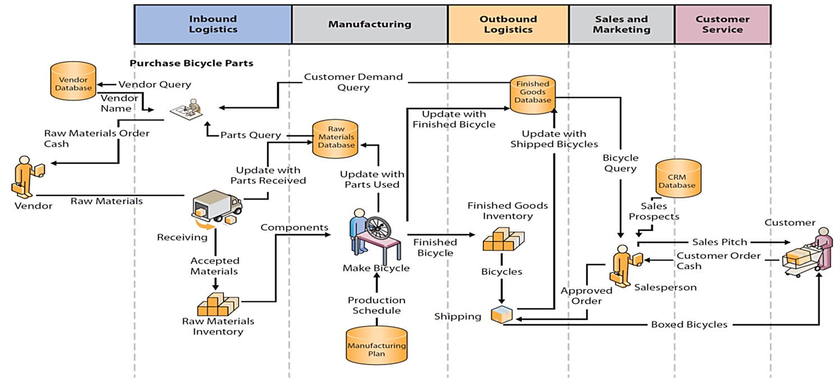
Pre-ERP Information System: Bicycle Manufacturer
Source: textbook[1], page 221
Notes:
This diagram represents processes used by a bicycle manufacturer. There are five non-integrated databases. Assume that the company has a separate accounting system (not shown) that is not integrated. With such a pre-ERP system, financial statements are always outdated and weeks late.

Slide 22
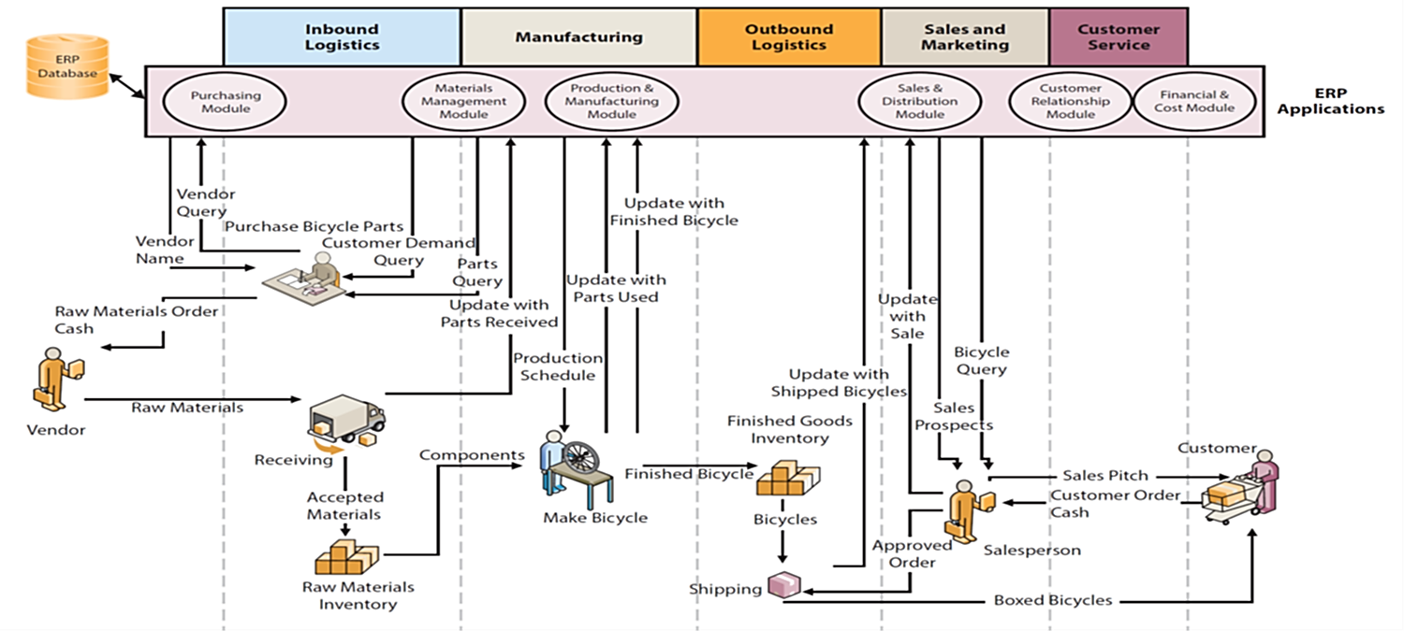
ERP Information Systems
Notes:
All activity processed by ERP applications and consolidated data are stored in a centralized ERP database.

Slide 23
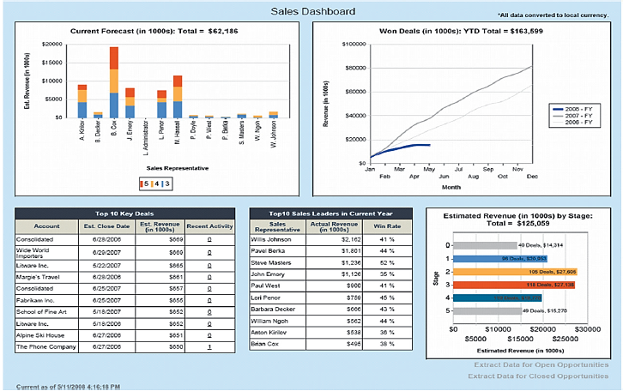
ERP Enabled Sales Dashboard
Notes:
With integration, ERP systems can display current status of critical business factors to managers and executives.

Slide 24
What Are the Elements of an ERP Solution?
ERP Application programs
ERP Business process procedures
ERP Databases
ERP Training and Consulting

Slide 25
ERP Solution Components
ERP Application Programs
Configurable vendor applications.
ERP Databases
Trigger
Computer program within the database that keeps database consistent when certain conditions arise.
Stored Procedure
Enforces business rules.
Notes:
Vendor applications: Configurable, can be altered without changing program code. Set configuration parameters specifying how ERP application programs will operate: Hourly payroll application configured to specify number of hours in standard workweek, hourly wages for different job categories, wage adjustments for overtime and holiday work, etc.
ERP Databases:
- Trigger: Database program to keep database consistent when certain conditions arise.
- Stored procedure: Database program to enforce business rules.

Slide 26
ERP Solution Components
ERP Business Processes and Procedures
Adapt to predefined, inherent processes and procedures, or design new ones?
ERP Training & Consulting
Training to implement.
Top management support, preparing for change, dealing with resistance.
Training to use.
Notes:
Super Users become in-house trainers; train the trainers.
Vendor and third-party consultants.

Slide 27
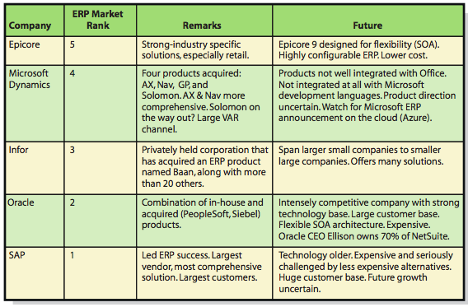
Top ERP vendors

Slide 28
Q5 What is SCM?

Slide 29
Supply Chain Management
Upstream activities
Improvement of business processes spanning organizational boundaries
Focus on upstream information flows
Acceleration of product development
Reduction of costs of raw materials procurement
Collaboration with suppliers (supply network)
Ability to compete more effectively in the market place
Cost reduction
Increased responsiveness to market demands

Slide 30
Supply Chain Management
Supply chain: the producers of supplies that a company uses
Suppliers work with additional suppliers
Supply network
Problems with not collaborating effectively
Information gets distorted
Forecast errors add up, leading to degradation of profitability and poor customer service
“Bullwhip effect”
Goals of improving upstream information flows
Accelerate product development
Reduce costs associated with procuring raw materials

Slide 31
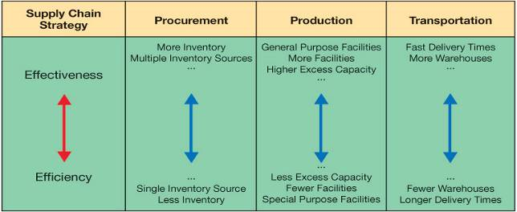
Developing an SCM Strategy
SCM efficiency and effectiveness need to be balanced
Efficiency—cost minimization
Effectiveness—customer service maximization
Tradeoffs—Supply chain strategy should match overall competitive strategy
Source: textbook[2], page 321

Slide 32
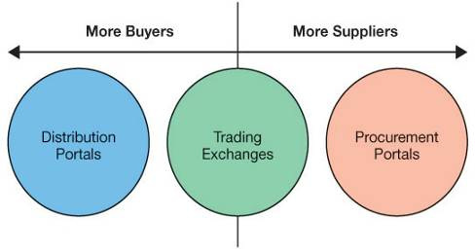
Emerging SCM Trends
Enterprise portals—B2B marketplace
Access point to proprietary information
Productivity gains and cost savings
Distribution portals
Products from single supplier to many buyers
Procurement portals
Procurement of products between single buyer and multiple suppliers
Source: textbook [2]

Slide 33
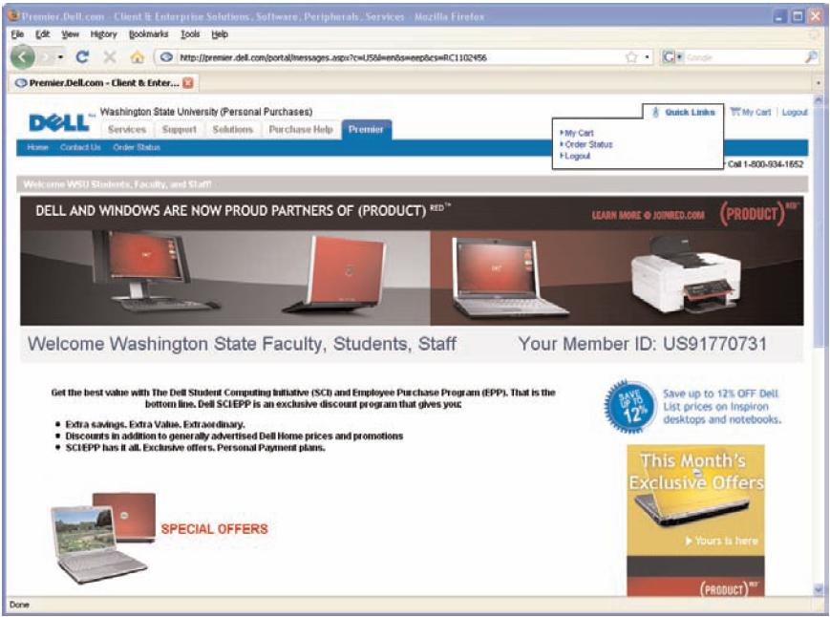
Example: Distribution Portal
Automation of business processes between supplier and multiple customers
Before transaction
During transaction
After transaction
Trading exchanges
Equilibrium between
buyers and sellers
Vertical markets
Source: http://www.dell.com

Slide 34
Trading Exchanges
Small companies don’t have funds for SCM
Trading exchanges provide a solution
Operated by third-party vendors
Revenue model
Commission for each transaction
Usage and association fees
Advertising
Many buyers and many sellers can come together
Popular trading exchanges:
www.scrapsite.com (steel)
www.paperspace.com (paper)
www.sciquest.com (medical equipment)

Slide 35
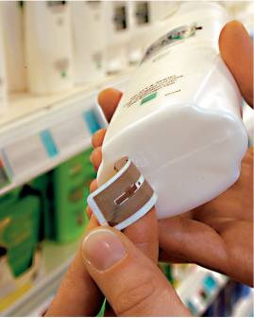
Radio Frequency Identification (RFID)
Replacement for standard bar codes
Transceiver and antenna
Line-of-sight reading not necessary
RFID tags can contain more information than bar codes
Diverse usage opportunities
Scanning can be done from greater distance
Passive tags—range of few feet
Active tags—range of hundreds of feet
Source: METRO AG.

Slide 36
Q&A

